Slide 1
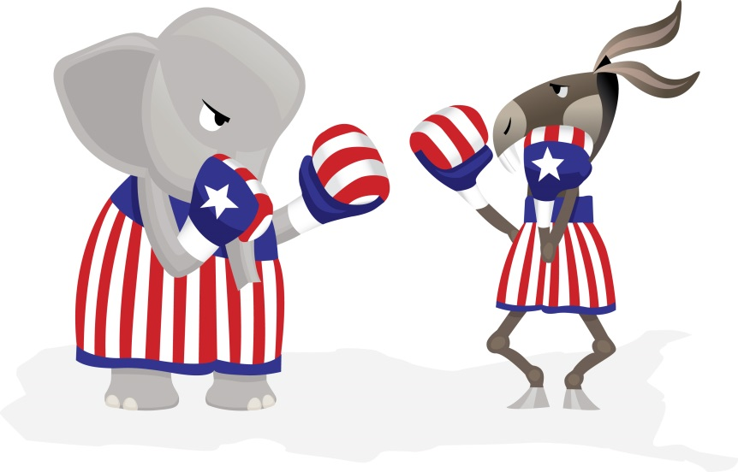
Election of 1860 vs Election of 2016
The election of 1860 divided the country.
Today we have an election in 2016 for president that is also dividing the country.
You and your partner will write a newspaper article on how the presidential election of 2016 is dividing the country. Cite any sources you may use. The article should be at least 2 pages.

Slide 2
1860 vs 2016
Skeleton outline plus your partner’s name is due before you leave today (hardcopy) or via email by midnight tonight
Monday/Tuesday – go to the computer lab
Research Monday/Tuesday
Final draft due Tuesday
Must have at least one person you interview (adult)

